Slide 1
Emotion Detection
of Text

Slide 2
Anshuman Singh
Krishna Kumar
Mohit Kumar Dubey
Shivam Singh Barman

Slide 3
Project Description
Emotions are expressed through words, gestures, expressions, and with the ease of accessibility of social media today, emotions can now also be expressed through tweets and instagram/whatsapp stories.

Slide 4
DATA PREPROCESSING

Slide 5
Cleaning Data

Slide 6
Removing Stop words, Duplicates and Lemmatization
Removed all the Null/NaN text from Dataset
Removed Stop Words and Punctuations
Lemmatised the text
Removed Duplicate Values
Resampling of Data

Slide 7
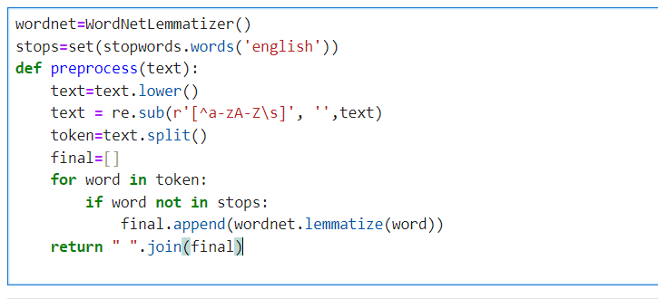
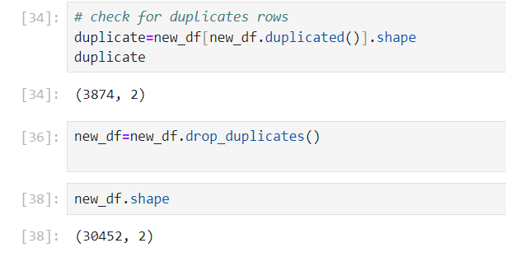

Slide 8
Why Resampling?
Resampling is a crucial technique in data preprocessing to address issues arising from imbalanced datasets.

Slide 9
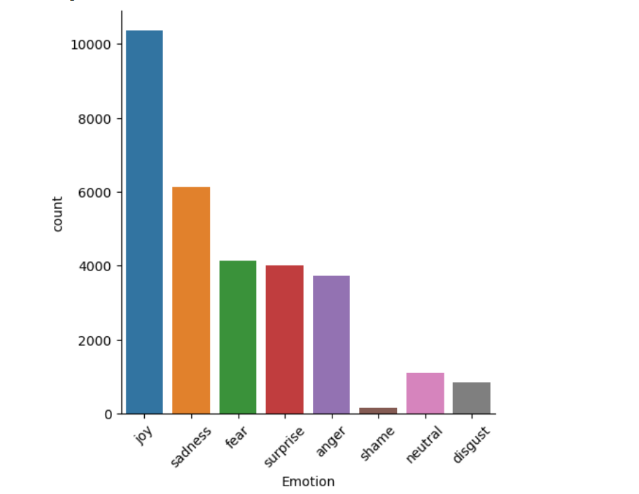
BEFORE RESAMPLING COLUMNS

Slide 10
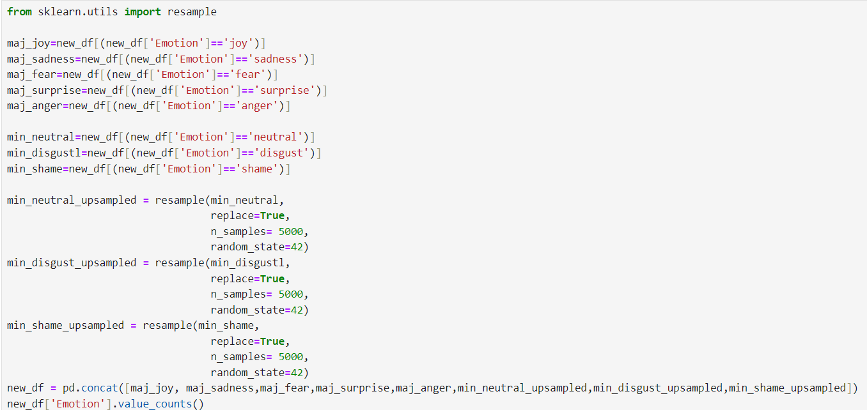

Slide 11
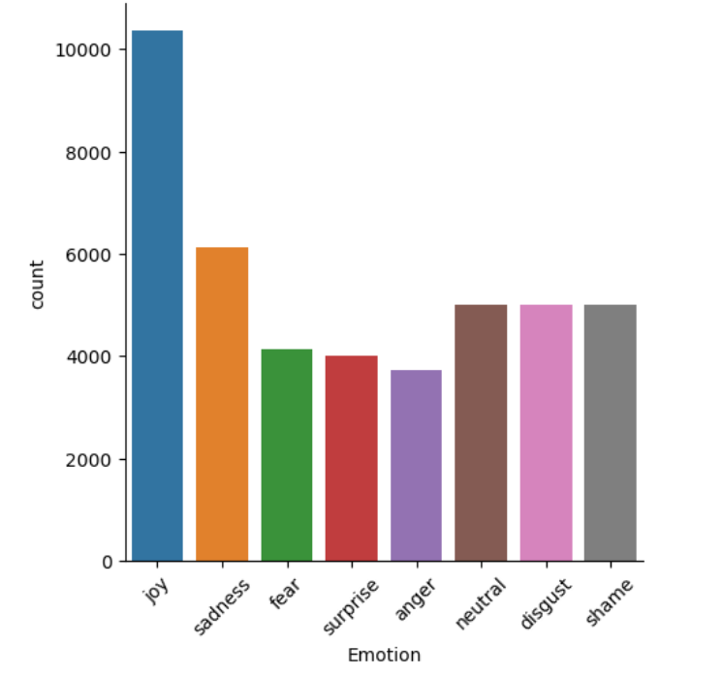
AFTER RESAMPLING COLUMNS

Slide 12
EXPLORATORY DATA ANALYSIS

Slide 13
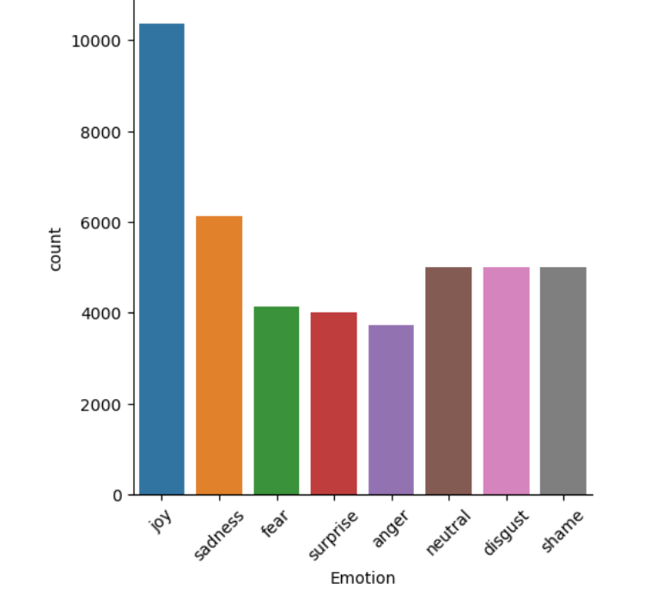
Types of Emotion
😊
JOY
😔
SAD
😐 NEUTRAL
🤢 DISGUST
🥲
SHAME
🥶
FEAR
🤯
SURPRISE
😡
ANGER

Slide 14
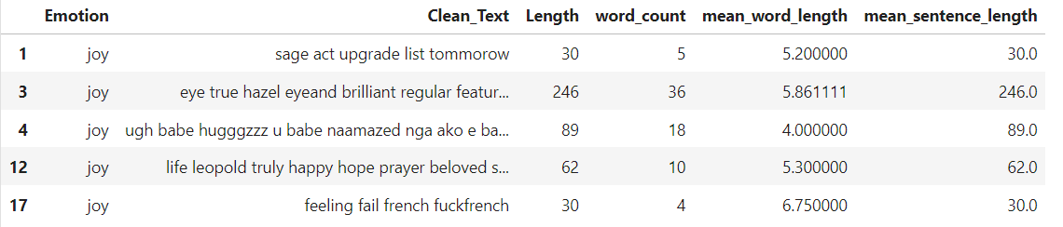
SENTENCES

Slide 15
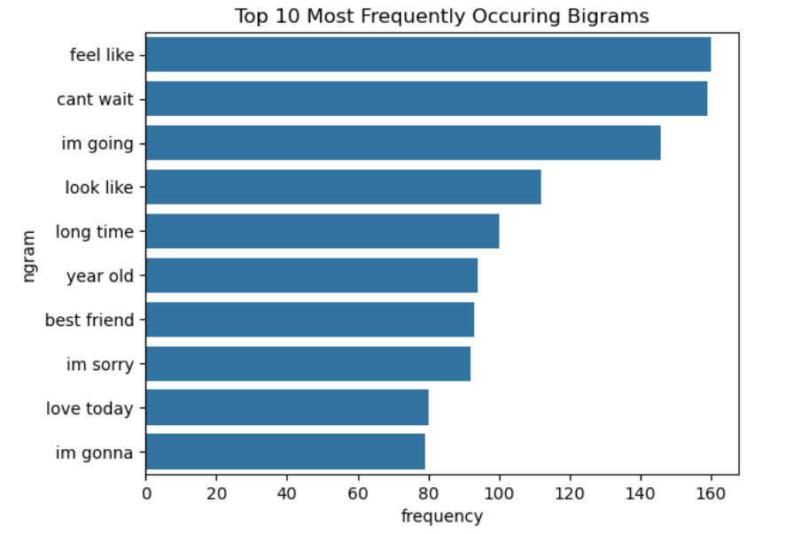
BIGRAMS

Slide 16
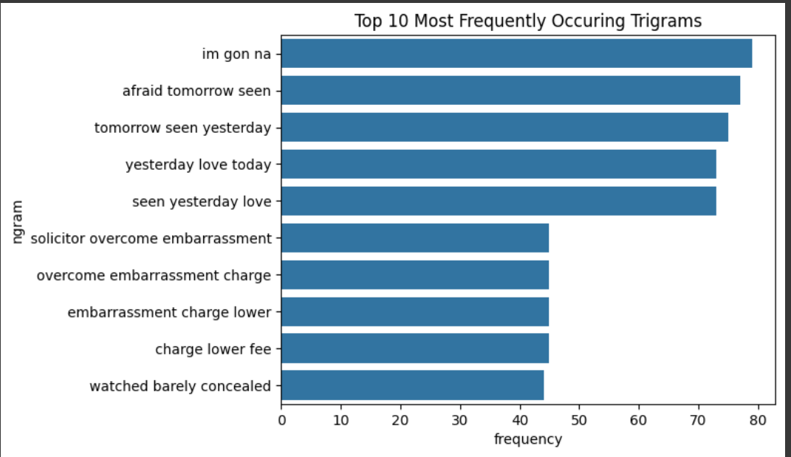
Trigrams

Slide 17
Model Training
Splitting the data into 70:30 ratio for training and testing.
Vectorizing the training data using Tf-idf vectorizer and using the vectorized data for training.

Slide 18
Models Implemented
Logistic Regression
Random Forest
Naive Bayes Classifier
Support Vector Machine

Slide 19
Logistic Regression
Logistic Regression is used as a foundational model due to its interpretability and efficiency, enabling us to quickly establish a baseline for predicting emotional states from textual features.
Random Forest
Random Forest is employed to enhance accuracy through ensemble learning, leveraging its capability to manage complex interactions between words and emotions, which is crucial for capturing nuanced emotional expressions in text.

Slide 20
Naive Bayes Classifier
Naive Bayes Classifier is chosen for its speed and effectiveness in text classification, particularly well-suited for our project as it can efficiently process large volumes of data while effectively categorizing emotions based on word frequency.
Support Vector Machine
Support Vector Machine is utilized for its strength in handling high-dimensional data, allowing us to create precise decision boundaries that differentiate subtle emotional nuances in the text, improving overall classification performance.

Slide 21
Results
Models Tested | Model Accuracy
Logistic Regression | 75.77
Random Forest | 77.71
Naive Bayes Classifier | 71.63
Support Vector Machine | 77.01

Slide 22
Thankyou!

